Slide 1
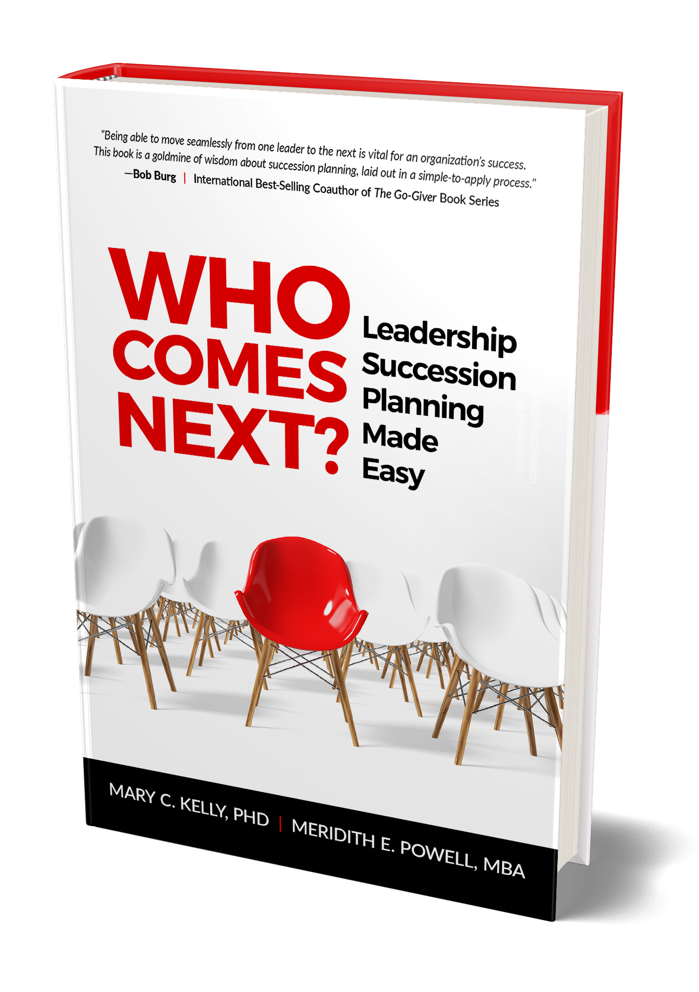

Slide 2


Slide 3


Who Comes Next?
Succession planning is all about answering the question: Who Comes Next? for organizations to
remain viable and become even more successful
Notes:
Leadership succession planning is the strategic process of answering that question: Who comes next to lead our company when the current leaders are gone? The goal is to solve the “people problem” faced by organizations of every size and shape: corporate entities, family businesses, closely held firms, nonprofits, and startups.

Slide 4

Who Comes Next?
Competition for effective leaders is high compared to the pool of available talent
Notes:
Great companies can’t function without great leaders. That’s always been a true statement, but now it comes with an ominous sense of urgency that we’ve never seen before. In our country today, the fierce competition for powerful leaders is accelerating at an unprecedented rate as the pool of available talent is shrinking.

Slide 5

THE PURPOSE
We can minimize the key players leaving our companies by giving them a career path
Notes:
Every business must accept the reality that people are going to change jobs, move, retire, become ill, or even die. We can't control when or how key players are going to leave our companies, but we can minimize that impact by having an effective plan to replace them.

Slide 6

THE PURPOSE
The scope of succession planning is much bigger and broader than simply identifying the next CEO
Notes:
A common misconception about succession plans is that they simply identify the next CEO and maybe a few VP spots. The scope is actually much bigger and broader. An ongoing process rather than a one-time task, succession planning involves finding the right people, hiring them, training them, rewarding them, keeping them, and preparing them for pivotal leadership roles.

Slide 7

THE PURPOSE
Succession planning ensures the long-term sustainability and growth of our organizations
Notes:
When developed and implemented properly, these plans can create a rich and continuous pipeline of top-level talent that will ensure the long-term sustainability and growth of our organizations. Granted, building and maintaining that pipeline requires some effort, but the results are well worth it.

Slide 8
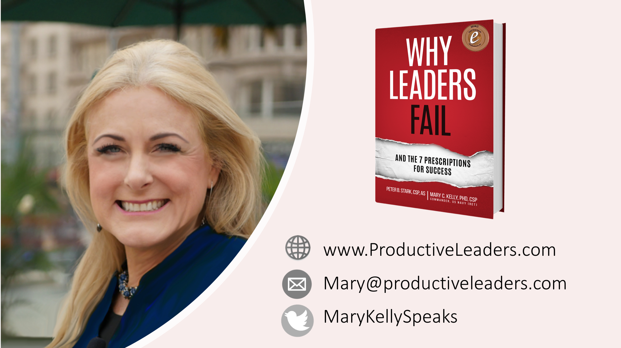
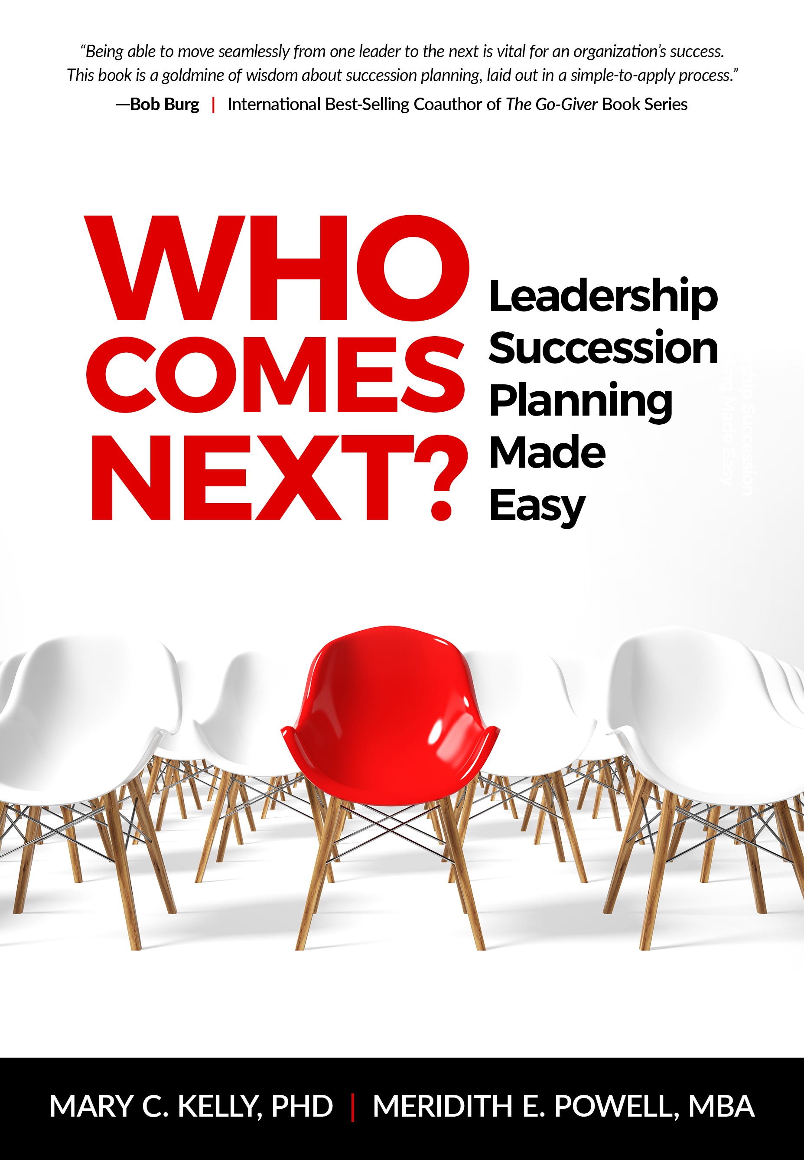
Don’t Reward Bad Behavior
Be Consistent

Slide 9

THE REWARDS
Executive teams diligently plant the seeds needed to grow exceptional talent, and they reap the rewards
Notes:
Today, executive teams from the most successful organizations understand the intrinsic value of succession planning and use it to their full advantage. They diligently plant the seeds needed to grow exceptional talent, and they reap the rewards.

Slide 10

1. UNDERSTANDING
the Urgent Need for Succession Plans
Understand demographic shifts
Uncovering talent shortages in the war for talent
Responding to the crisis
Making the commitment

Slide 11


Understand demographic shifts
Approximately one-third of our country’s total workforce in 2019 comes from the 75 million Baby Boomers (those born roughly 1944-1964)
However, approximately 10,000 Boomers turn 65 years of age every single day
People are eyeing their 401(k)s and
calendars to determine when they can comfortably head for the exit and start their retirement

Slide 12

“It’s no longer a question of simply finding talent; we need to build it.”
-Jonas Prising
ManpowerGroup Chairman & CEO

Slide 13

  Responding to the crisis
A CNBC survey found that 28 million small businesses currently operate in the U.S., and more than half of the owners are over age 50
While 78% of those owners intend to sell their businesses when they retire, only 30% had taken time to develop a viable succession plan

Slide 14
  Responding to the crisis
For many organizations, the procrastination occurs because they have no idea how to get started
Succession planning can be complex, and sometimes leaders feel overwhelmed by obstacles
    Will the soon-to-be-outgoing CEO be offended if they bring up the subject?
    Will employees start to feel anxious about the future?
    Will customers get nervous about the implications for them?

Slide 16

Realize
the need for succession planning now
Thanks to global competition and the digital evolution, the pace of business today continues to escalate.
Fewer employees scramble to cover the same intense workload. Higher demands and lower budgets often add fuel to the fire.

Slide 18
2. EXPLORING
the Mindset of the Outgoing Leader
Understand the challenges
Overcome the reluctance
Overcome the obstacles
Build the team

Slide 19

Outgoing Leader
What happens if those top leaders flat-out don’t want to discuss retirement or even think about a day when their names aren’t on the corner office? What if you are…ahem…the person avoiding the topic?
1
2
3
4
Either way, it’s a serious roadblock

Slide 20
Understand the Challenges
From perspective of senior executives, retirement may represent a sense of loss. Loss of purpose. Loss of power. Loss of structure, camaraderie and validation
They’ve spent their entire careers building a legacy, and that construction stops the day they
walk away
We can’t emphasize enough how difficult it is for leaders to relinquish companies they’ve been running for decades, especially if they built
them from ground up

Slide 21
Overcome the Reluctance
If you are the person at the top, we encourage you to talk with a
trusted advisor about your perceptions of retirement and the implications that would have for your daily life
  Do you dream about it or dread it?
  Have you already made exciting plans for that phase of life?
  Or does it make you so uncomfortable that you vow to work every day until you physically cannot keep going?

Slide 22
Overcome the Obstacles
“I don’t completely trust anyone to take over”
Bring in more talent with senior-level experience and proven track records.
Increase responsibilities of in-house candidates to help determine their readiness for executive leadership.
Provide more shadowing opportunities directly with leaders.
This is totally understandable.
It may even be warranted.
However, organizations can manage this sentiment by implementing policies:

Slide 23

“No one else knows what I know”
This is probably a true statement
Top executives do have a depth of specialized knowledge that made it possible for their companies to succeed
So sharing that information should begin immediately
Overcome the Obstacles

Slide 28

Build the team
“I’m the only person driving innovation”
If top leaders believe they are carrying that burden alone, they need to implement changes right away.
Building a corporate culture that encourages and rewards creativity from every single employee produces breakthrough concepts.

Slide 29
3. Employee impact and involvement
Answer employee questions
Find out what employees are thinking
Be transparent
Alter the perception of turnover
Make the process collaborative

Slide 30

Employee Impact
Every single employee within a company feels the impact of changes in leadership

Slide 31

1. Will the new CEO take the company in a different direction and eliminate our division?
2. If the owner retires or leaves, will the company shut its doors?
3. Will I still have a job?
4. If my boss moves to another department, who will I report to?
5. How will that affect my annual review and my bonus?
6. Are there any legitimate opportunities for advancement here?
7. How long am I going to be stuck in this position?
8. What’s the probability of getting a promotion at this company?
9. What will it take for me to be promoted?
1. Answer common employee
questions

Slide 32

Alter perception of turnover
1
The U.S. military — known for its system of growing talent and promoting within the organization — provides us with great examples of turnover by design
2
3
4

Slide 33
WHO COMES NEXT
Turnover by Design
A Military Approach
People in the military know that they will change jobs and locations every 2-3 years. Even with that level of purposeful turnover, the military remains mission focused and combat ready. Could your organization benefit from following this proven approach?
© 2020 Mary C. Kelly and Meridith Elliott Powell. All rights reserved.

Slide 34

“Wait, you sleep here?”

Slide 35
Alter perception of turnover
1
Retired Navy Commander Theresa Kelly succinctly summarized this attitude:
"Something my first Chief taught me was to lead so that, if you didn't show up one day, everything would run perfectly. When you make yourself irreplaceable, you are letting your organization down."
2
3
4

Slide 37

“This is your office?”
Notes:
In the military there are paths to success. Everyone prepares to leave their job as soon as they arrive. The goal? Make the next person successful.

Slide 38
4. Why Succession
Planning Matters to Your Customers
Communicate the strategy
Strengthen relationships
Reassure delivery

Slide 39

1. Communicate the strategy
Your clients, customers, suppliers, and retailers need
to know that you are stable and planning for the future

Slide 40


Slide 41

Communicate the strategy
When you communicate with customers about internal personnel changes, you honor relationships
The key here is to be proactive and keep conversation at the appropriate level
No granular details. No drama or gossip. Just information about upcoming transitions that could affect business partnership
1
2
3
4
Customers (and potential customers) deserve that

Slide 42
Strengthen Relationships
When you are honest with your customers about changes, you are actively building that sense of trust
They will appreciate information, and you can reassure them of continuity surrounding their accounts
If changes have ramifications for their business, you’re in position to make recommendations for adjustments
1
2
3
4

Slide 43
Reassure Delivery
We need to approach our employees and customers as partners
We need to share information, and they will be more likely to reciprocate
We are better positioned to keep the business flourishing because of relationships we nurtured
1
2
3
4

Slide 44
5. Creating a Strategy for
Talent
Rethink your corporate structure
Design organizational chart
Develop criteria/competencies
Analyze your HR inventory
Create the avatar
Reality check
Get employee feedback
Design talent pathways

Slide 45

1. Rethink Corporate Structure
In many cases, succession planning process prompts you to
think about your organization in a fresh way
Refined vision gives you perspective to see that future success
would be greater if you restructure your leadership team
You might discover the need to add positions
that do not currently exist
Use this opportunity to reimagine the optimal architecture
for your human resources
1
2
3
4

Slide 46
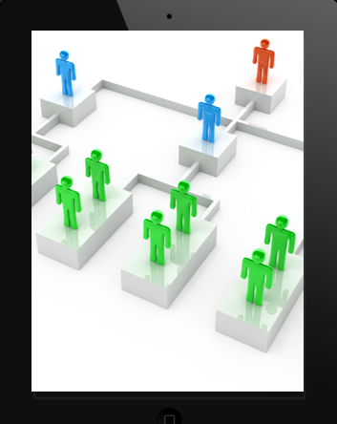
2. Design organization chart
A dynamic organization chart becomes the graphic
representation of the succession plan
We’ve provided a list of options in our Resource Guide, and
you can find dozens more online
Select one that offers the level of detail to support your chosen
planning model (targeting all man-agement positions, the top
Five executives, or something in between)
1
2

Slide 47

3. Develop Criteria/Competencies
Instead of populating your new organization chart with
names of potential candidates, focus first on descriptions of
the talent required for future success
Basically, you are creating detailed job descriptions for all
of the succession-targeted positions
1
2

Slide 48

1. Business Judgment
2. Conflict Management Skills
3. Crisis-Management Experience
4. Decision-Making Skills
5. Emotional Intelligence
6. Entrepreneurship
7. Financial Acumen
8. Industry Knowledge
  Some competencies might include

Slide 49
9. Influence
10. Integrity and Moral Courage
11. Interpersonal Skills
12. Networking & Relationship Building
13. Strategic Thinking
14. Talent Development
15. Vision
  Some competencies might include

Slide 50

4. Analyze your HR inventory
This process has the potential to upset some employees who
assumed they would be promoted
But the long-term success of the company depends on moving
the most qualified people into your targeted positions
So, what’s the smartest way to solve this “people puzzle” and
define the best career paths for your talent pool?
1
1
2
2
3
3
4

Slide 51
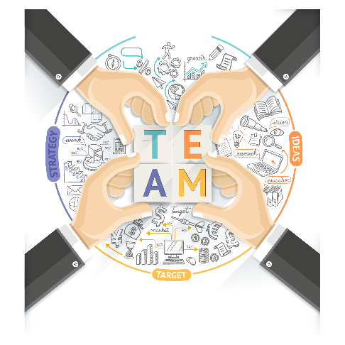
5. Create the Avatar
The second option is to work with a small, elite team to create
an “avatar” of the perfect future leader
Identify the ideal attributes, characteristics, skills, and talents of
the best possible person when your current leader departs
This avatar gives you a more quantitative way to evaluate
candidates as you compare them with the fictitious gold standard
1
2
3

Slide 53

6. Reality Check
Do we always know what our people are doing?
Do we know what they want?
If we populate the organization chart based on our
assumptions, we could be wrong
We need to know our people and what they want.
That means getting them involved
1
1
2
2
3
3
4

Slide 54

7. Get employee feedback
To create our talent strategy, we have to get the talent involved
We need to get their ideas so we can understand what they
want and where they want to go within the organization
If you’re using Open Recruitment Model, that means you’ll want to
engage in succession conversations with every leadership employee
1
1
2
2
3
3
4

Slide 55

8. Design talent pathways
At this phase, you’ve gathered the feedback you need to begin
developing a fluid version of your organization chart
Think about the expected career trajectory for
each targeted employee
Then visualize how that flow of talent through the organization
would impact results over time
In other words, begin designing talent pathways that will make
sense for the organization and for the employees
1
1
1
2
2
2
3
3
3
4
4

Slide 56

Ask the right questions!
Cultivating leaders starts with honest and open conversations. Ask!

Slide 57

Where do you see yourself
in 3-5 years with us? What
do you picture doing?
____________________________
____________________________
____________________________

Slide 58

What parts of this business/mission interest you?
____________________________
____________________________
____________________________

Slide 59

Where are you
now in terms of your
next position?
Totally ready now
Very well-prepared
Somewhat ready
Hopeful to start preparing

Slide 60

What current skills
do you have that align
well with your future
desired position?
a. _______________________
b. _______________________
c. _______________________

Slide 61

What skills do you
want to develop to be successful in your
future roles?
a. _______________________
b. _______________________
c. _______________________

Slide 62

What is the plan of
action to develop those critical skills?
a. _______________________
b. _______________________
c. _______________________

Slide 63

What skills do you
want to develop to be successful in your
future roles?
a. _______________________
b. _______________________
c. _______________________

Slide 64
6. Managing
the succession planning process
Long-term maintenance
Must be continuous
Transition management
Transparent movements

Slide 65

1. Long-term maintenance
Deliver on your promise
Everyone on the payroll will be watching to see whether your declaration was an empty corporate platitude or a rock-solid promise

Slide 66

2. Must be continuous
Succession planning is
an ongoing process
A continuously evolving activity is designed to sustain your company’s growth over time. It’s not something you can knock out at an executive retreat and cross it off your list

Slide 67

3. Transition management
Changing of the guard
When one of your top leaders leaves and another one takes over, your ability to manage these transitions plays a big role in how employees perceive succession as a fundamental part of your organization

Slide 68

4. Transparent movements
Here are some steps to follow when you are expecting a top-level transition:
Be transparent about transition
Let employees know, in advance, the relevant details relating to the transition
Remember to provide them with updates as the situation fluctuates
Being open about leadership changes demonstrates the organization’s commitment to partnering with employees through the succession process

Slide 69

7. Troubleshooting
the succession planning process

Slide 70


Troubleshooting
Don’t expect immediate perfection
Know that you will have to constantly adjust
“What if our CEO won’t discuss succession?”
“What if our CEO refuses to step down?”
“What if the heir apparent to our family business is the wrong person?”
“What if high turnover is undermining our succession plan?”
“What if our employees are overly anxious about succession?”
“What if some of our leaders just won’t leave?”

Slide 71
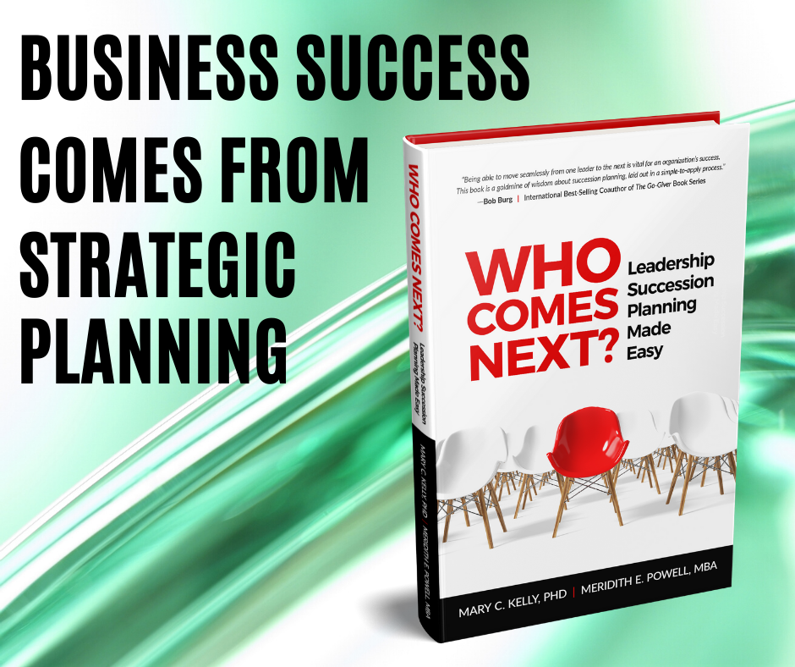

Slide 72
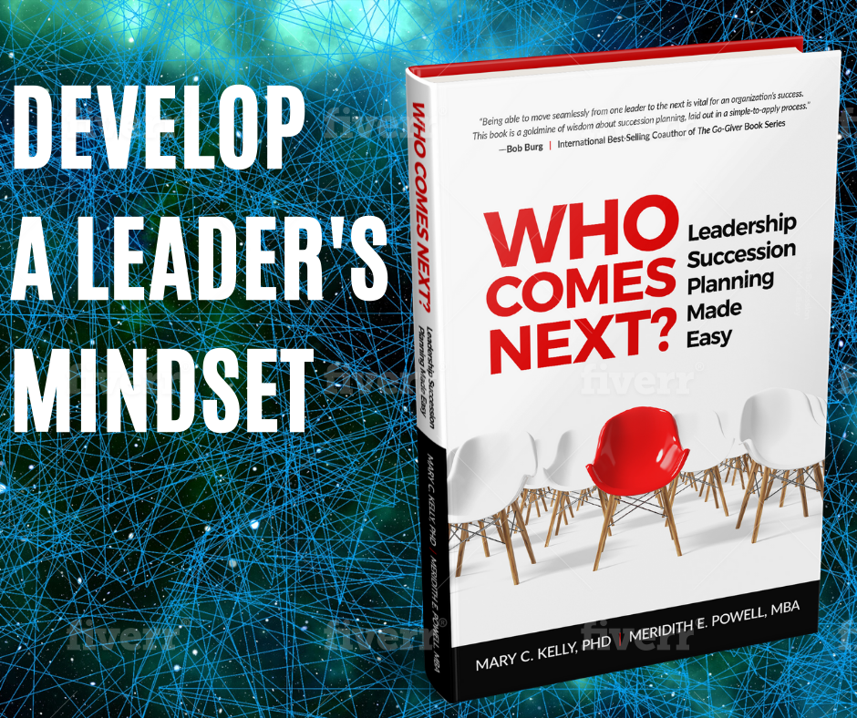

Slide 73
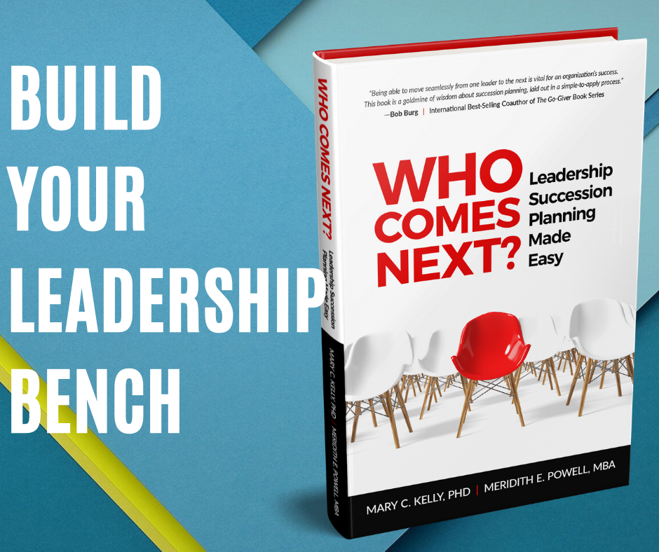

Slide 74
Every organization needs a plan for leadership succession!
*Communicate with customers about the change
*Identify talent gaps in your succession plan
*Decide which succession planning model to adapt
*Find your next generation of leadership within your organization
*Handle the unique emotional complexities of succession in a family-owned business
Whether you are part of a small, family business, a Fortune 500 company or a non-profit, you need to start now by answering the question: WHO COMES NEXT?
More resources: https://whocomesnext.com/
Get a free chapter!
Get the Tools workbook for free by emailing the paperback receipt to info@ProductiveLeaders.com!

Slide 75
Don’t Reward Bad Behavior
Be Consistent

